Slide 1
ENERGY PREDICTION MODEL FOR SEATTLE BUILDINGS
Vincent SALAS
Date: January 09, 2022

Slide 2
TABLE OF CONTENTS
01
CHALLENGE INTERPRETATION
02
EXPLORATORY ANALYSIS
03
MODELING TESTING
04
FINAL RESULTS
05
ENERGY RECORD INTERVALS

Slide 3
01 CHALLENGE INTERPRETATION

Slide 4

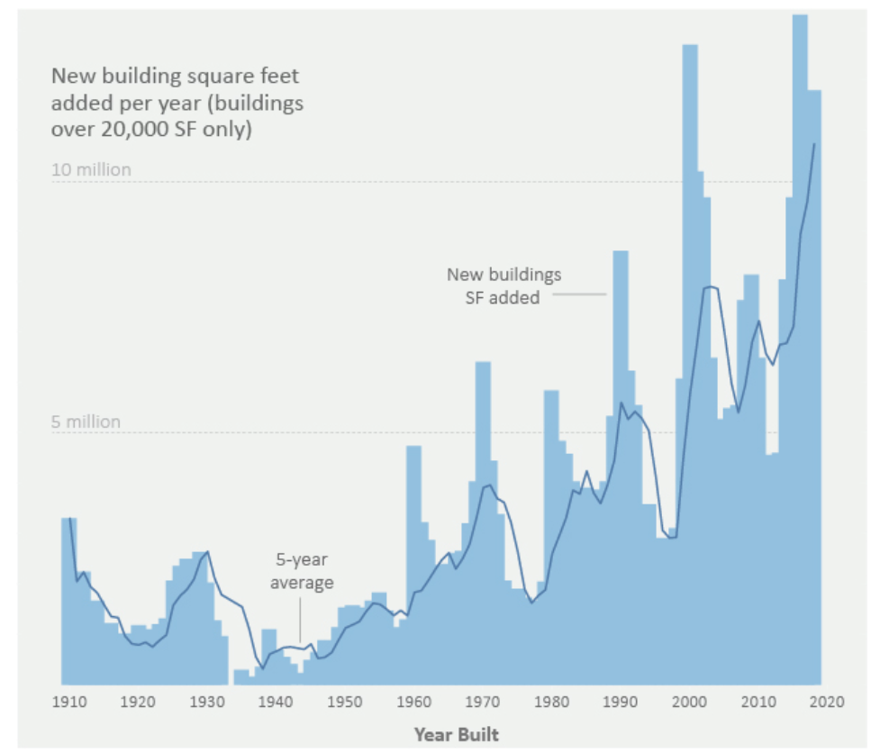
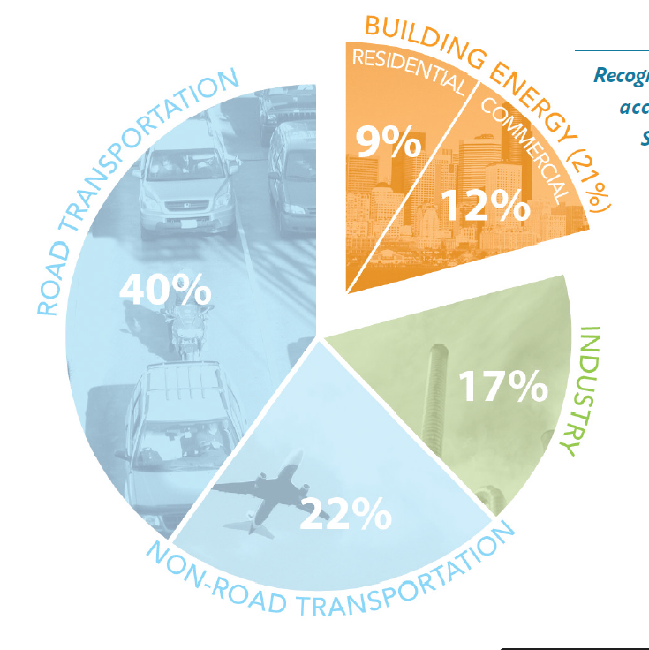

SEATTLE CARBON FOOTPRINT
The consumed energy of buildings is responsible for 20% of the Seattle carbon footprint

Slide 5

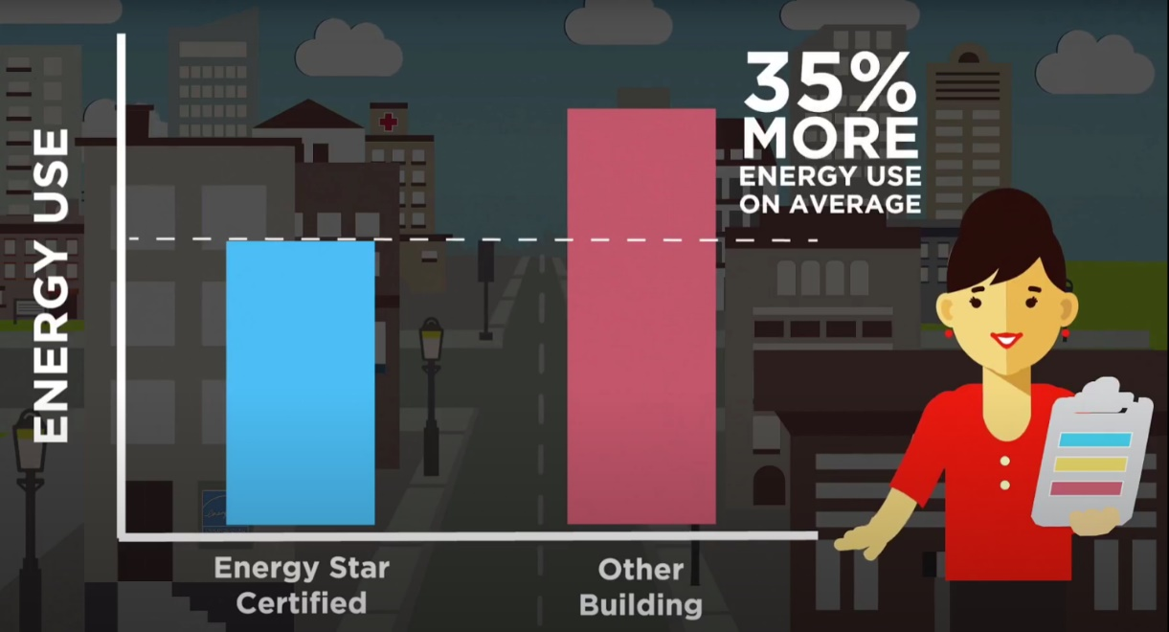
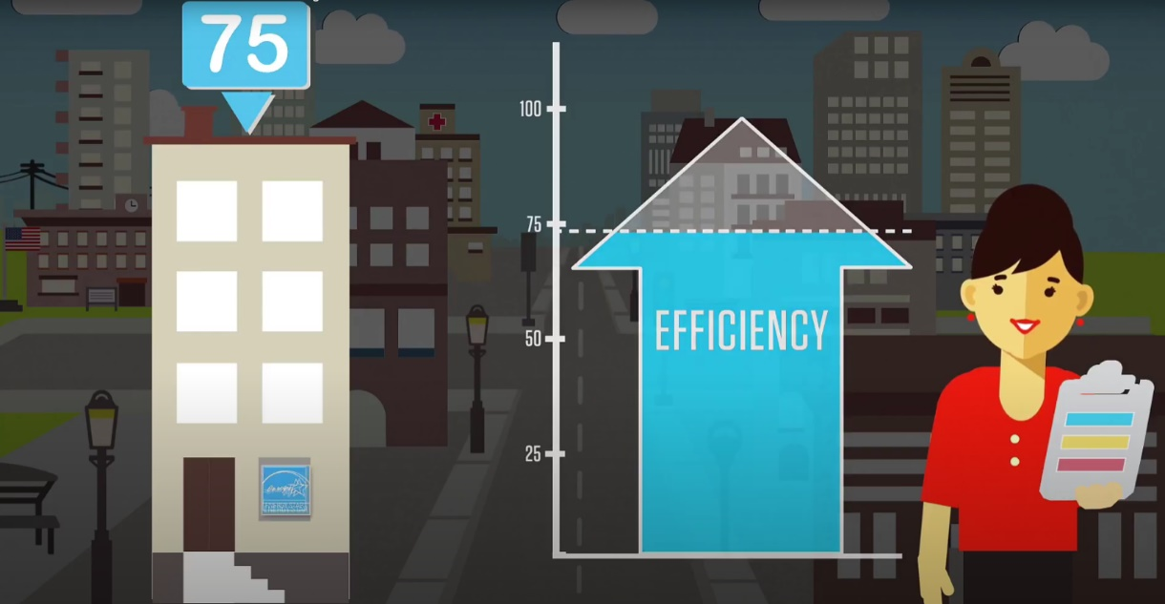
ENERGY STAR SCORE
Score that allows an energy efficiency certification

Slide 6
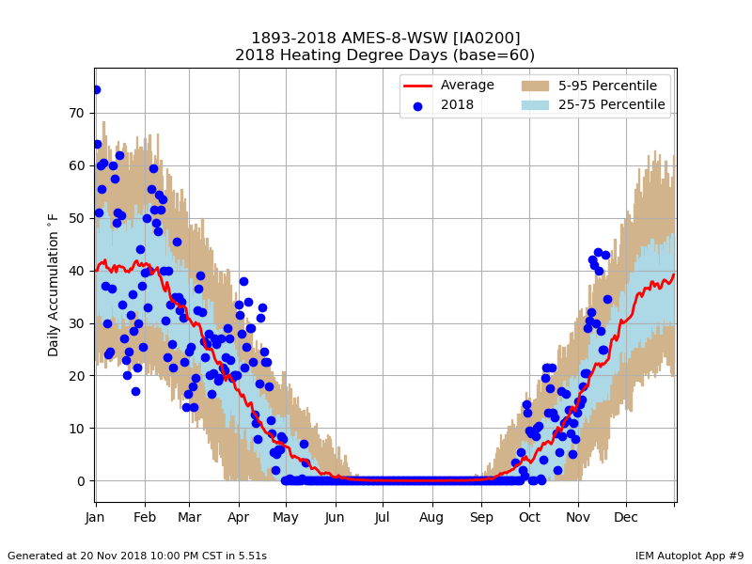

WEATHER NORMALIZED
Portfolio Manager uses a grid of weather stations
Wheather and climate data enable to correlate the energy consumption with the local temperature
The weather normalised energy allows a better comparison from year to year

Slide 7
Which predictive target shall we select?

Slide 8
02 EXPLORATORY ANALYSIS

Slide 9
SEATTLE DATA CLEANING
Buildings are deleted when meeting the following conditions:
Energy collection data is missing
Surfaces are missing
Energy type inconsistent from year to year
Energy variation > 50% from year to year
Outliers detected
Your audience will listen to you or read the content, but won’t do both.

Slide 10
DATA CLEANING
Second
predicted year
Predicted year
 | 2015 | 2016 | 2017 | 2018 | 2019
Independent set | 3340 | 3376 | 3461 | 3537 | 3581
Cleaned set | 3253 | 3211 | 3191 | 3537 | 3268
Filter on:
Outlier
- Status « not compliant »

Slide 11
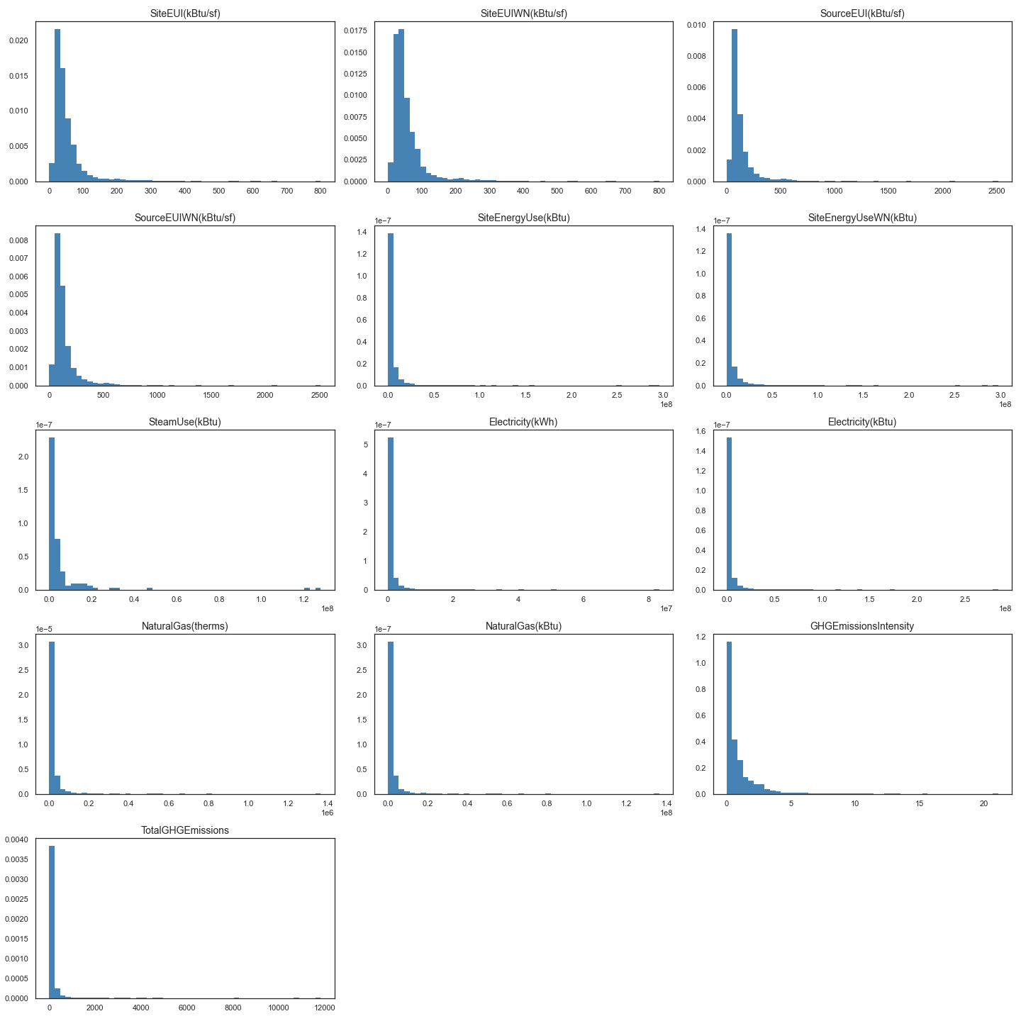
UNIVARIATE ANALYSIS
We observe data concentration

Slide 12
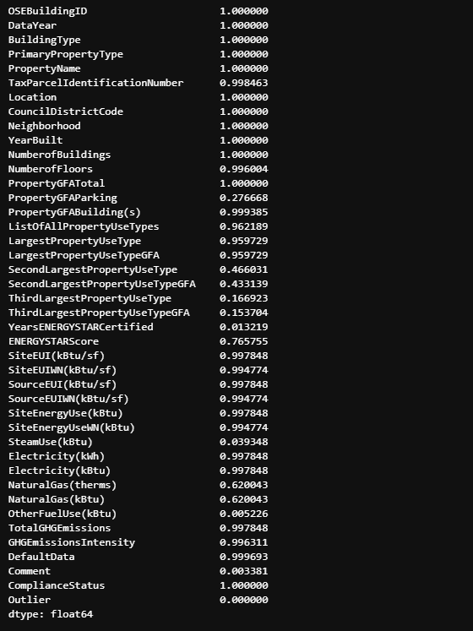
MEDIAN IMPUTATION
For measured values (with filling rate > 75%)
For characteristics:
'NumberofBuildings’
'NumberofFloors’
- For 'ENERGYSTARScore'

Slide 13
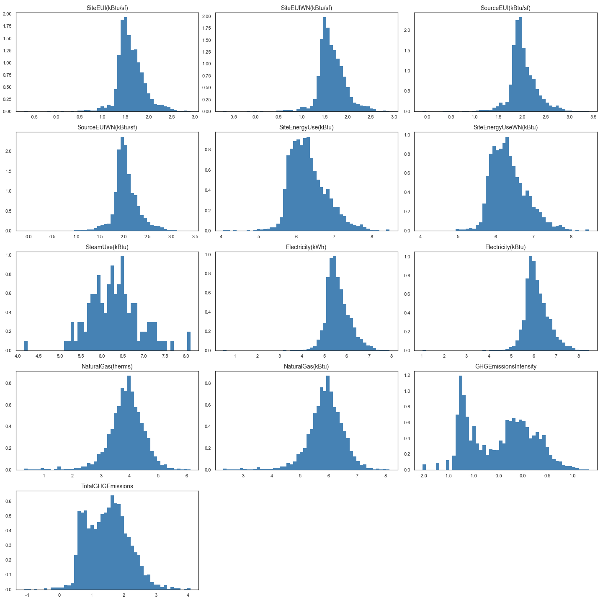
UNIVARIATE DISTRIBUTION
Then we apply a log transformation
to have a better distribution

Slide 14
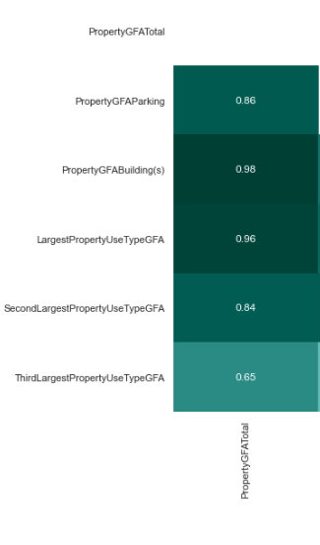
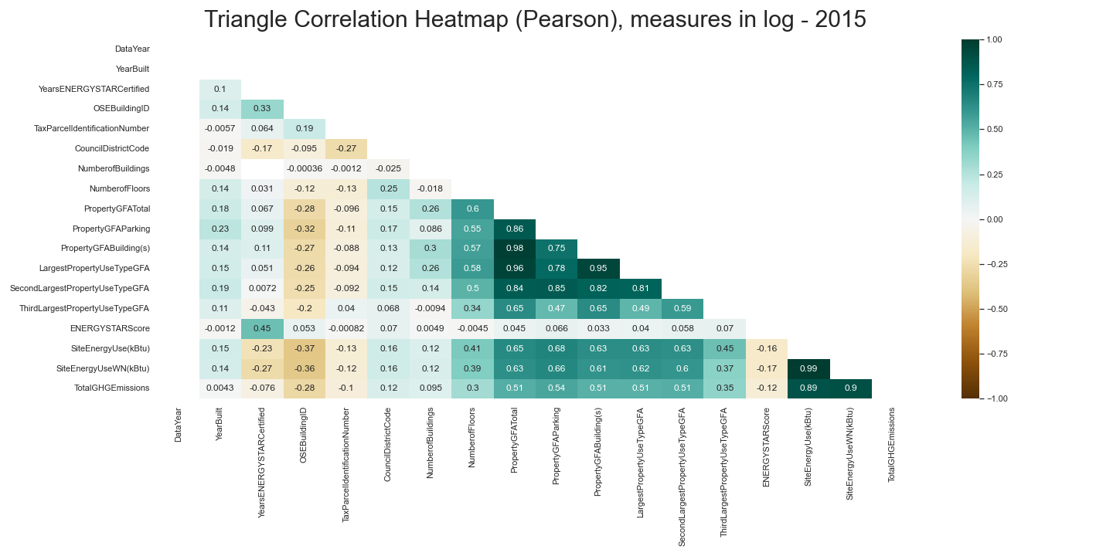
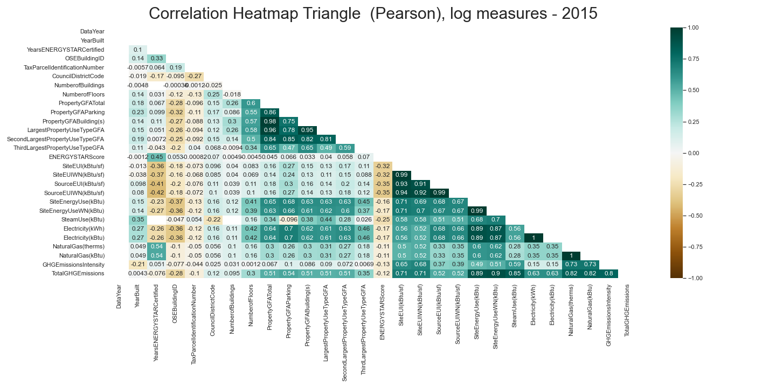
NUMERICAL CORRELATIONMATRIX
The numerical variables
'SiteEnergyUse(kBtu)’,
'SiteEnergyUseWN(kBtu)’
'TotalGHGEmissions’
are kept
The categorical variables
'LargestPropertyUseTypeGFA', 'PropertyGFABuilding(s)', 'PropertyGFAParking', 'SecondLargestPropertyUseTypeGFA’
can be deleted
Good correlation
between
'SiteEnergyUse(kBtu)’
and
'SiteEnergyUseWN’

Slide 15
The consumed energy with normalized weather is selected as a predictive target
'SiteEnergyUseWN(kBtu)'
A correction will then be applied depending on the year to predict and the weather recorded (wait for the end of the year)

Slide 16
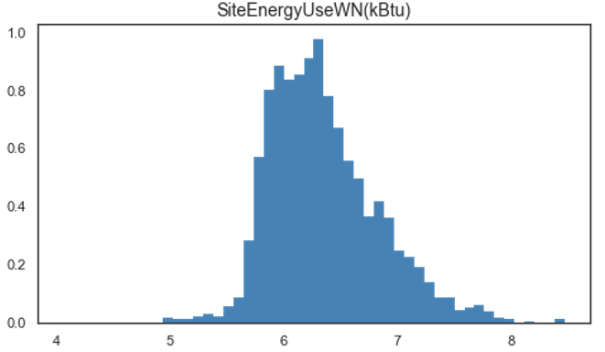
CATEGORICAL VARIABLES
Variables are created: primary, secondary, tertiary energy type: [electricity, gas, steam]
Discretisation of the target=> q=[0, 0.05, 0.7, 0.95, 1] 'SiteEnergyUseWN(kBtu)’, value limits of classes are frozen in 2015

Slide 17
CATEGORICAL VARIABLES New categories
'PrimaryPropertyType’:
10 hierarchical classes are created
Multifamily Housing | Office | Education | Mixed Use Property | Logistic/Distribution centers
1 | 2 | 3 | 4 | 5
Commercial centers | Hotel/Restaurant | Health services | Industry | Other/Public places
6 | 7 | 8 | 9 | 10

Slide 18
CATEGORICAL VARIABLES Encoding
Label encoding:
'SiteEnergyUseWN(kBtu)'
Target encoding:
'PrimaryPropertyType’
'LargestPropertyUseType’
'CouncilDistrictCode’
'energy_type_01’
'energy_type_02’
'energy_type_03'

Slide 19
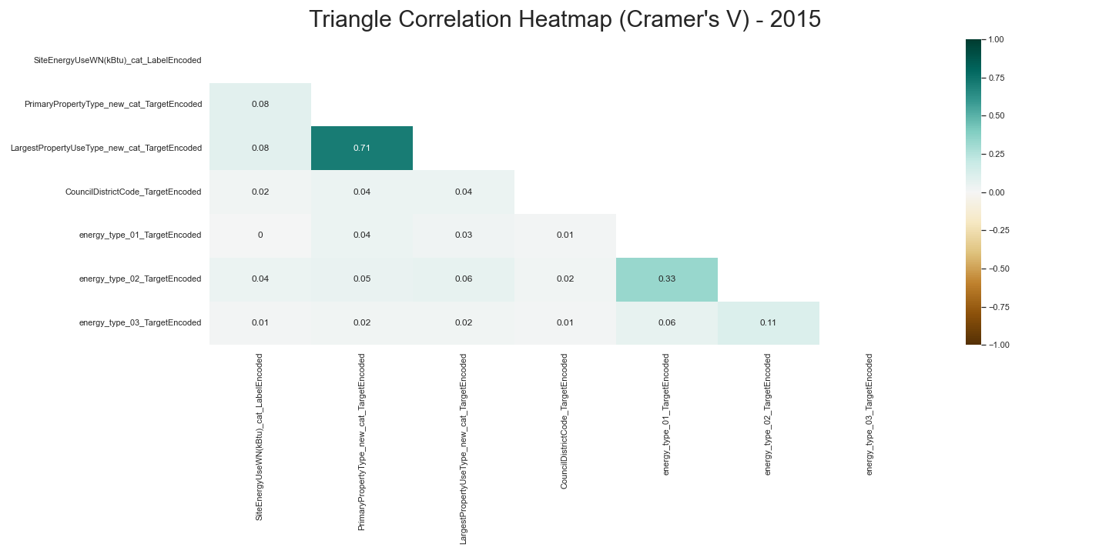
CATEGORICAL CORRELATION MATRIX
…

Slide 20
03 MODELING TESTING

Slide 21
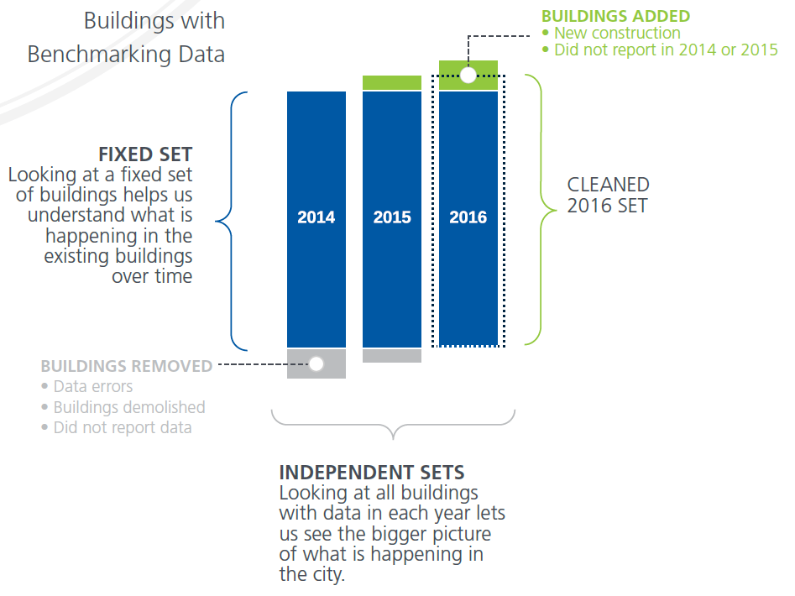

ANALYSIS APPROACH

Slide 22
“FIX SET”
Second
predicted year
Predicted year
 | 2015 | 2016 | 2017 | 2018 | 2019
Independent set | 3340 | 3376 | 3461 | 3537 | 3581
Cleaned set | 3253 | 3211 | 3191 | 3537 | 3268
Fix set | 2588 | 2588 | 2588 | 2588 | 2588
Buildings followed for 3 years at the end of 2017

Slide 23


Bât | 2015 | 2016 | 2017 | 2018 | 2019
1 | X | X | X. | X ∆ | X ∆
2 | X | X | X. | X ∆ | X ∆
3 | X | X | X. | X ∆ | X ∆
4 | X | X | X. | X ∆ | X ∆
5 | X | X | X. | X ∆ | X ∆
6 | X | X | X. | X ∆ | X ∆
7 | X | X | X. | X ∆ | X ∆
8 | X | X | X. | X ∆ | X ∆
9 | X | X | X. | X ∆ | X ∆
10 | X | X | X. | X ∆ | X ∆
11 |  | X | X | X. ∆ | X ∆
12 |  | X | X | X. ∆ | X ∆
13 |  |  | X | X | X. ∆
14 |  |  | X | X | X. ∆
15 |  |  |  | X | X
16 |  |  |  |  | X
Tested in 2018 and 2019 on the fix set but there is a risk of overlearning
Train/Validation/Test sets
2018 and 2019 predicted
Training set
Fix set
(2017+)
Random draw of a building from the selected years
a
Validation set
Inputs
Fix set
(2018+)
Test set 2018 and 2019
(building entererd in the fix set after 2015
=
2 consecutive years chosen)
Inputs
Fix set
(2019+)
b
Out of scope
X: record
X.: 3rd record
Predictive conditions OK
Predictive conditions NOK
∆: predictive value at the end of the year

Slide 24
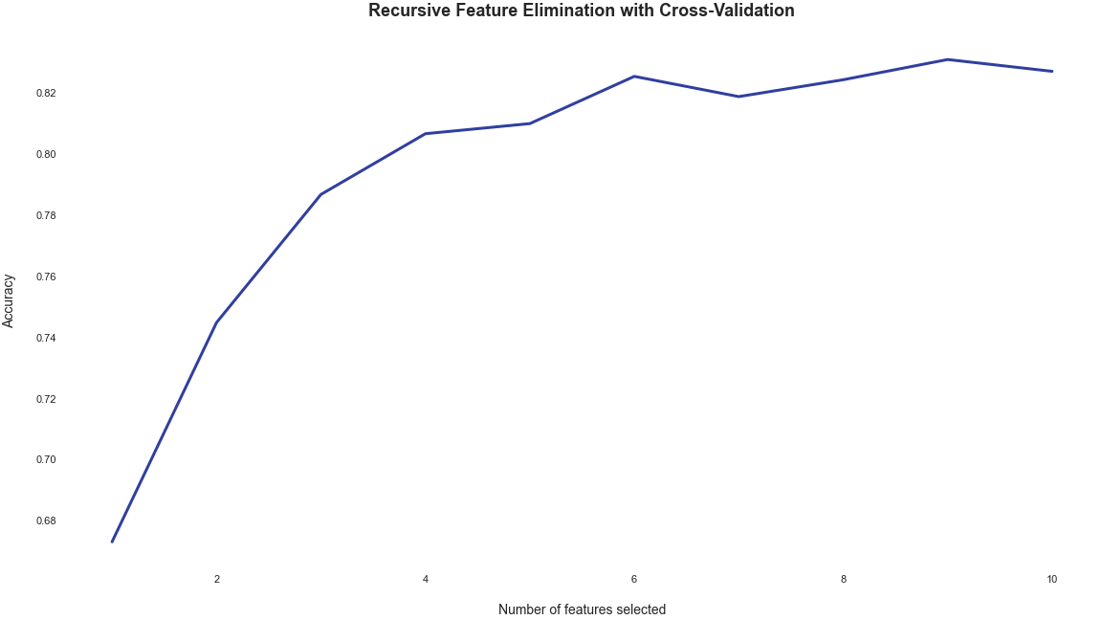
FEATURE SELECTION
RFECV:
6 features

Slide 25
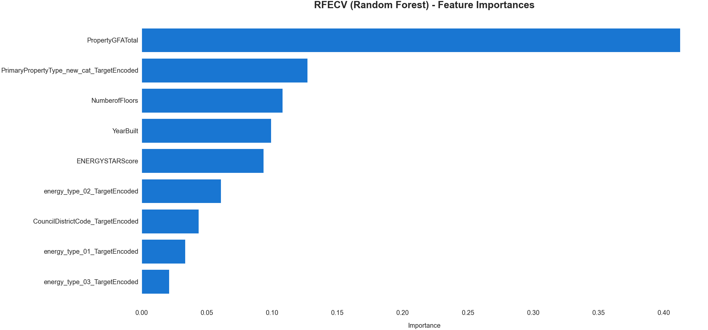
FEATURE SELECTION
RFECV:

Slide 26
EVOLUTIVE VARIABLES
EnergyStarScore
The only variable taking into account the user behaviour
PrimaryPropertyType
In case the owner changes
energy_type_01/02/03
In case the energy type changes

Slide 27
CATEGORICAL VARIABLES One Hot Encoding
'PrimaryPropertyType_new_cat’
'energy_type_02’

Slide 28
04 FINAL RESULTS

Slide 29
FEATURES
Standardisation of training data
['PropertyGFATotal', 'YearBuilt', 'ENERGYSTARScore', 'NumberofFloors’,
'energy_type_02_<electricity>', 'energy_type_02_<gas>', 'energy_type_02_<steam>', 'energy_type_02_<Class Missing>’,
'PrimaryPropertyType_new_cat_<Commercial centers>', 'PrimaryPropertyType_new_cat_<Education>', 'PrimaryPropertyType_new_cat_<Health services>', 'PrimaryPropertyType_new_cat_<Hotel/Restaurant>', 'PrimaryPropertyType_new_cat_<Industry>', 'PrimaryPropertyType_new_cat_<Logistic/Distribution centers>', 'PrimaryPropertyType_new_cat_<Mixed Use Property>', 'PrimaryPropertyType_new_cat_<Multifamily Housing>', 'PrimaryPropertyType_new_cat_<Office>', 'PrimaryPropertyType_new_cat_<Other/Public places>', 'PrimaryPropertyType_new_cat_<Class Missing>']

Slide 30
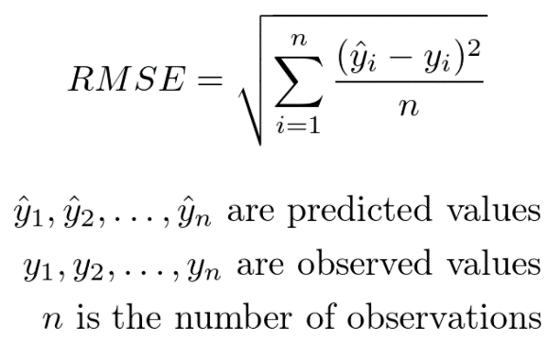
METRICS
(numerical target)
RMSE:
Calculation time (fit + testing)

Slide 31
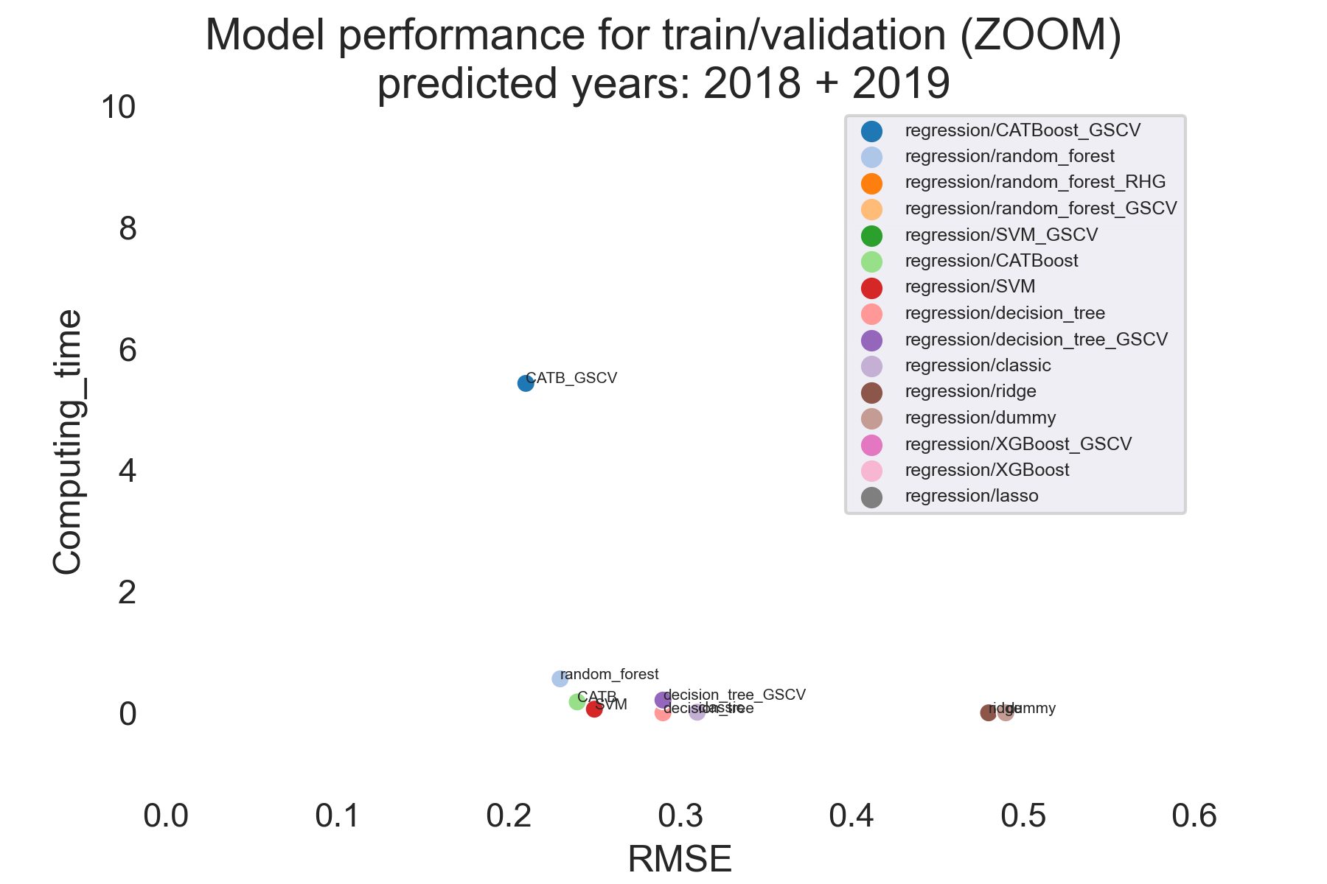
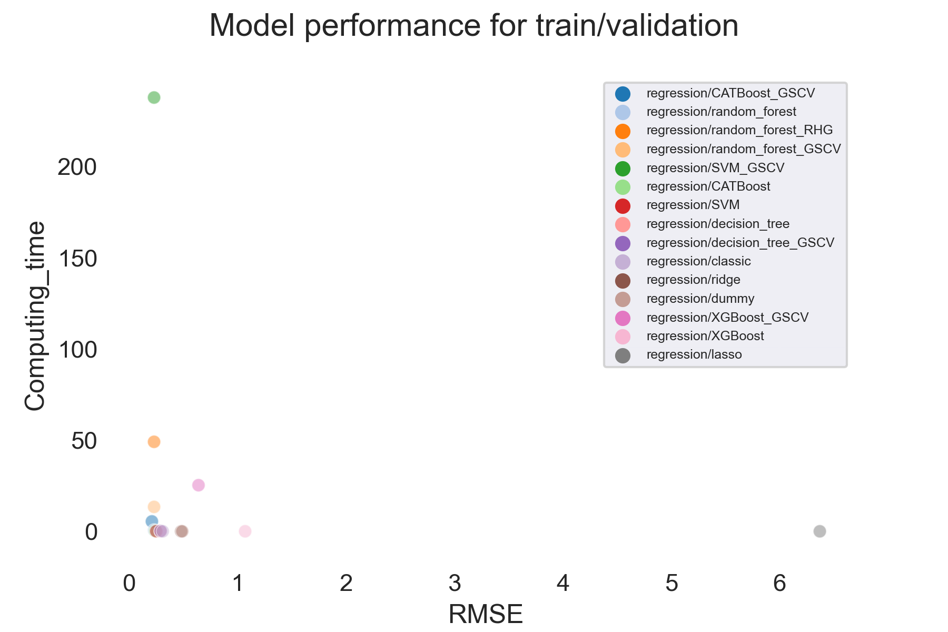
TRAIN/ VALIDATION RESULTS
4 models
pre-selected

Slide 32
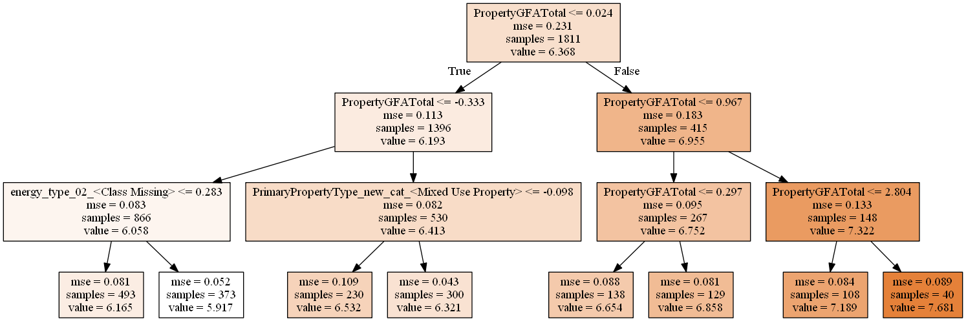
INTERPRE- TABILITY
Complete yes for DecisionTreeRegressor

Slide 33
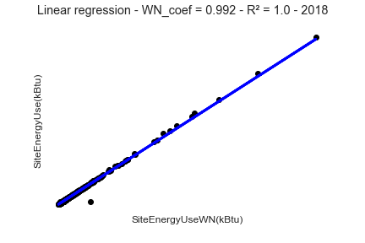
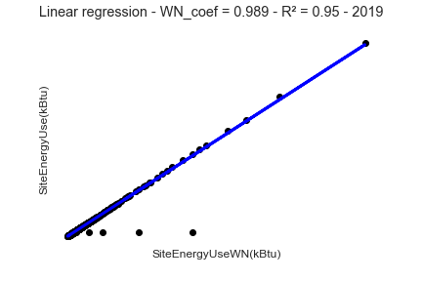
TEST PREPARATION 2018 2019
We deduce 'SiteEnergyUse(kBtu)’ from the predicted values with the following regression:

Slide 34
2018 TEST RESULTS
Part a (known buildings)
Part b (new buildings)
 |  | Model | RMSE
 | Set_part_2018
1 | a | random_forest_regressor | 0.20
2 | a | SVM_regressor | 0.25
3 | a | CATBoost_regressor | 0.26
4 | a | decision_tree_regressor | 0.29
baseline | a | dummy_regression | 0.49
Predicted years:
2018
2019
Fixed set:
2588 buildings
 |  | Model | RMSE
 | Set_part_2018
1 | b | random_forest_regressor | 0.31
2 | b | CATBoost_regressor | 0.33
3 | b | SVM_regressor | 0.34
4 | b | decision_tree_regressor | 0.38
baseline | b | dummy_regression | 0.61

Slide 35
2019 TEST RESULTS
Part a (known buildings)
Part b (new buildings)
 |  | Model | RMSE
 | Set_part_2019
1 | a | SVM_regressor | 0.25
2 | a | CATBoost_regressor | 0.26
3 | a | decision_tree_regressor | 0.29
4 | a | random_forest_regressor | 0.29
baseline | a | dummy_regression | 0.49
Predicted years:
2018
2019
Fixed set:
2588 buildings
 |  | Model | RMSE
 | Set_part_2019
1 | b | random_forest_regressor | 0.31
2 | b | CATBoost_regressor | 0.33
3 | b | SVM_regressor | 0.34
4 | b | decision_tree_regressor | 0.38
baseline | b | dummy_regression | 0.61

Slide 36
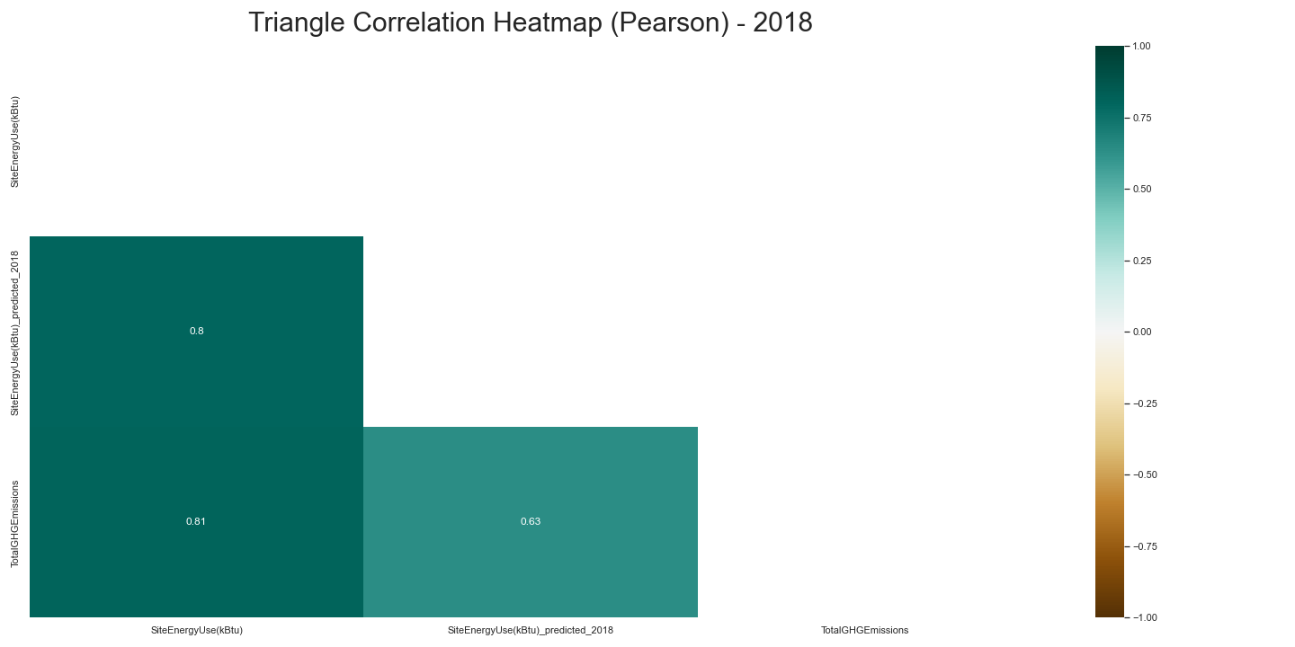
EVOLUTION OF CORRELATION (on fix set)
Correlation of Energy predicted / GHG Emissions

Slide 37
We transfer this methodology to predict 2019/2020

Slide 38
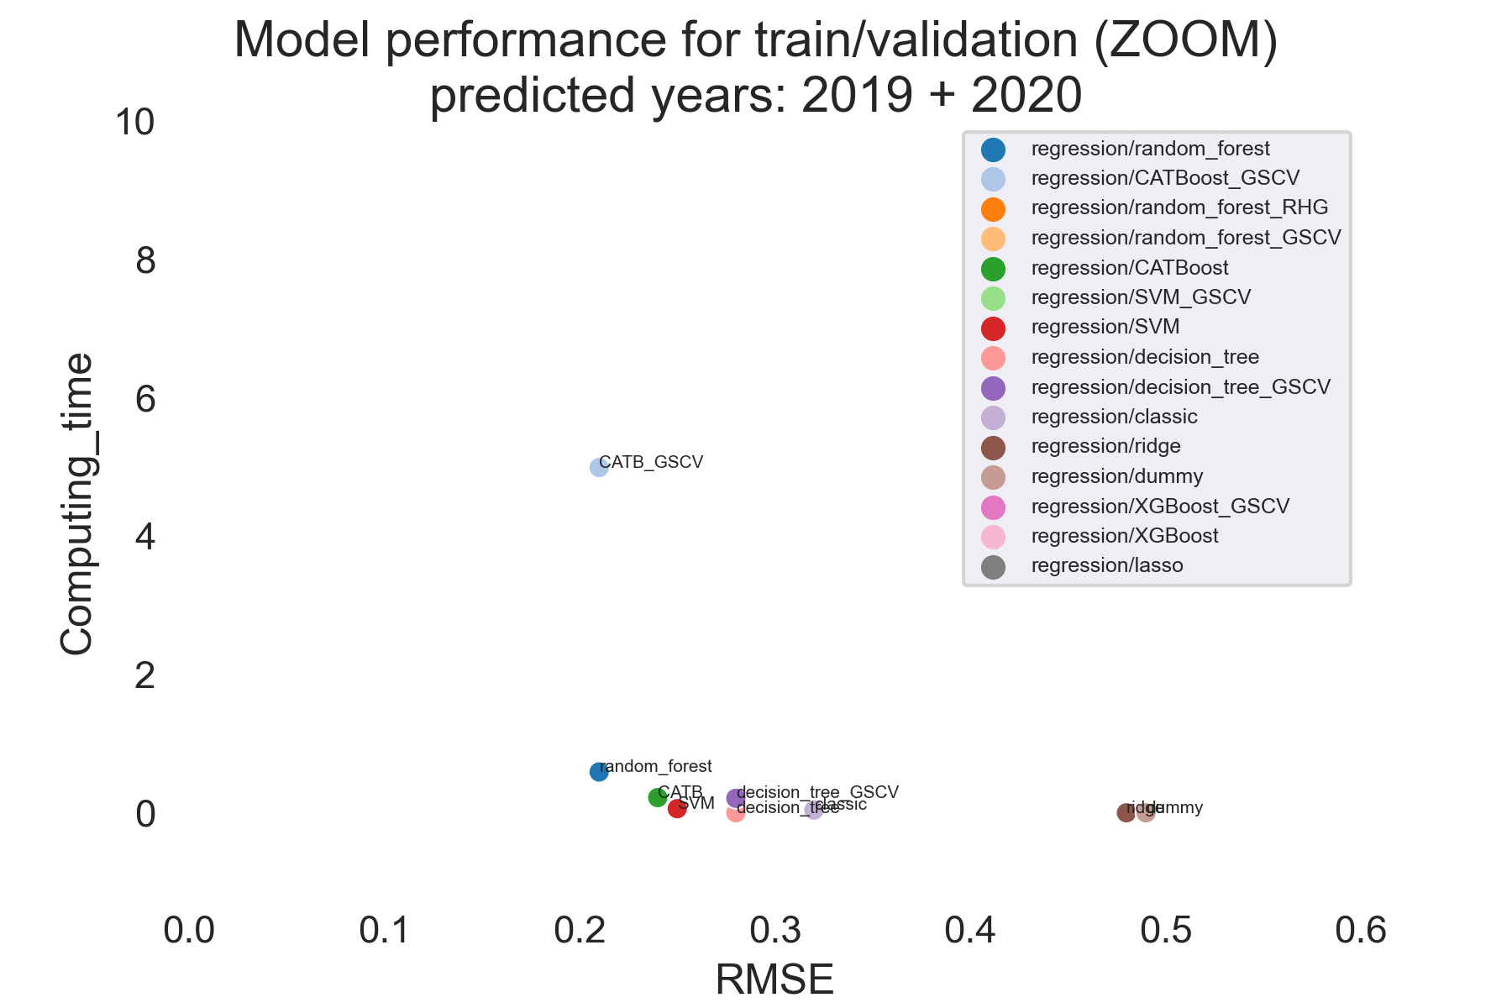
TRAIN/ VALIDATION RESULTS
Predicted years:
2019
2020
Fixed set:
2631 buildings

Slide 39
2019 TEST RESULTS
Part a (known buildings)
Part b (new buildings)
 |  | Model | RMSE
 | Set_part_2019
1 | a | random_forest_regressor | 0.18
2 | a | CATBoost_regressor | 0.24
3 | a | SVM_regressor | 0.24
4 | a | decision_tree_regressor | 0.28
baseline | a | dummy_regression | 0.49
Predicted years:
2019
2020
Fixed set:
2631 buildings
 |  | Model | RMSE
 | Set_part_2019
1 | b | random_forest_regressor | 0.23
2 | b | CATBoost_regressor | 0.27
3 | b | SVM_regressor | 0.27
4 | b | decision_tree_regressor | 0.28
baseline | b | dummy_regression | 0.48

Slide 40
2020 TEST RESULTS
Part a (known buildings)
Part b (new buildings)
 |  | Model | RMSE
 | Set_part_2020
1 | a | CATBoost_regressor | 0.25
2 | a | SVM_regressor | 0.26
3 | a | decision_tree_regressor | 0.29
4 | a | random_forest_regressor | 0.29
baseline | a | dummy_regression | 0.49
Predicted years:
2019
2020
Fixed set:
2631 buildings
 |  | Model | RMSE
 | Set_part_2020
1 | b | random_forest_regressor | 0.23
2 | b | CATBoost_regressor | 0.27
3 | b | SVM_regressor | 0.27
4 | b | decision_tree_regressor | 0.28
baseline | b | dummy_regression | 0.48

Slide 41
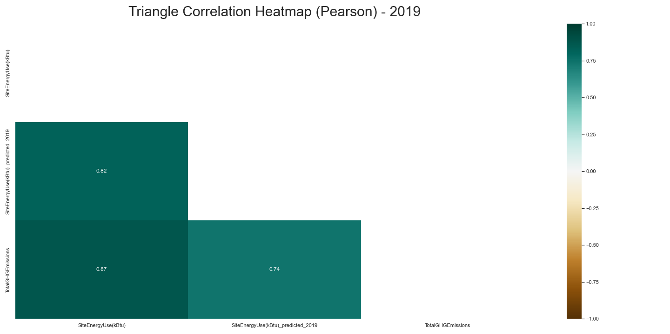
EVOLUTION OF CORRELATION (on fix set)
Correlation of Energy predicted / GHG Emissions

Slide 42
05 ENERGY RECORD INTERVALS

Slide 43
RECORD INTERVALS PROPOSITION
Record intervals can be implemented when two predictive years are validated for a building
One year is added to the current two predicted years of the model (with at least 3 training years)
Only 20% of records each year -> cost saving
Each followed building has a record every 5
years to validate the prediction and to have
new building data input
The selected buildings must be removed
from the training set for the current year
Check out the following record intervals scenario from 2022 until 2030/2050:

Slide 44

Building/year | 2015 | 2016 | 2017 | 2018 | 2019 | 2020 | 2021 | 2022 | 2023 | 2024 | 2025 | 2026 | 2027 | 2028 | 2029 | 2030…2050
1 | X | X | X. | X | X | X ∆ | X ∆ | X ∆ | ∆ | ∆ | ∆ | ∆ | X ∆ | ∆ | ∆ | ∆
2 | X | X | X. | X | X | X ∆ | X ∆ | X ∆ | ∆ | ∆ | ∆ | ∆ | X ∆ | ∆ | ∆ | ∆
3 | X | X | X. | X | X | X ∆ | X ∆ | ∆ | X ∆ | ∆ | ∆ | ∆ | ∆ | X ∆ | ∆ | ∆
4 | X | X | X. | X | X | X ∆ | X ∆ | ∆ | X ∆ | ∆ | ∆ | ∆ | ∆ | X ∆ | ∆ | ∆
5 | X | X | X. | X | X | X ∆ | X ∆ | ∆ | ∆ | X ∆ | ∆ | ∆ | ∆ | ∆ | X ∆ | ∆
6 | X | X | X. | X | X | X ∆ | X ∆ | ∆ | ∆ | X ∆ | ∆ | ∆ | ∆ | ∆ | X ∆ | ∆
7 | X | X | X. | X | X | X ∆ | X ∆ | ∆ | ∆ | ∆ | X ∆ | ∆ | ∆ | ∆ | ∆ | X ∆
8 | X | X | X. | X | X | X ∆ | X ∆ | ∆ | ∆ | ∆ | X ∆ | ∆ | ∆ | ∆ | ∆ | X ∆
9 | X | X | X. | X | X | X ∆ | X ∆ | ∆ | ∆ | ∆ | ∆ | X ∆ | ∆ | ∆ | ∆ | ∆
10 | X | X | X. | X | X | X ∆ | X ∆ | ∆ | ∆ | ∆ | ∆ | X ∆ | ∆ | ∆ | ∆ | ∆
11 |  | X | X | X. | X | X ∆ | X X | X | X. ∆ | X ∆ | X ∆ | ∆ | ∆ | ∆ | ∆ | X ∆
12 |  |  |  | X | X | X. ∆ | X ∆ | X ∆ | ∆ | ∆ | ∆ | ∆ | X ∆ | ∆ | ∆ | ∆
13 |  |  |  |  | X | X ∆ | X. ∆ | X ∆ | X ∆ | ∆ | ∆ | ∆ | ∆ | X ∆ | ∆ | ∆
14 |  |  |  |  | X | X ∆ | X. ∆ | X ∆ | X ∆ | ∆ | ∆ | ∆ | ∆ | X ∆ | ∆ | ∆
15 |  |  |  |  |  | X | X | X. ∆ | X ∆ | X ∆ | ∆ | ∆ | ∆ | ∆ | X ∆ | ∆
16 |  |  |  |  |  |  | X | X | X. ∆ | X ∆ | X ∆ | ∆ | ∆ | ∆ | ∆ | X ∆
Validation
+
New
training data
Deleted from the training set
+
New
training data
Transition to intervals conditions
+
Test on new buildings
Input in the fix set the current year
X Record
X. 3rd record
Intervals conditions NOK
∆ predicted data
X ∆ ou (planned)
X: incorrect record
or prediction
Intervals conditions OK

Slide 45
CONCLUSION
A predictive model will be chosen with the following goals:
Good tradeoff between error/computing time
Good results on new buildings
Good stability between predicted years
Good interpretability (public impact)
The training strategy takes into account the data fiability and data science rules
Possibility to include new training data when available
The EnergyStarScore is kept to take into account the user improvements in the model
Is prediction possible until 2050 with the weather normalization method? If not, what is the time window?
Energy record intervals proposed to reduce record costs

Slide 46

THANKS
Do you have questions?
@V_SalasRichard

Slide 47
APPENDIX A: 2018/2019 predictions without the EnergyStarScore feature

Slide 48
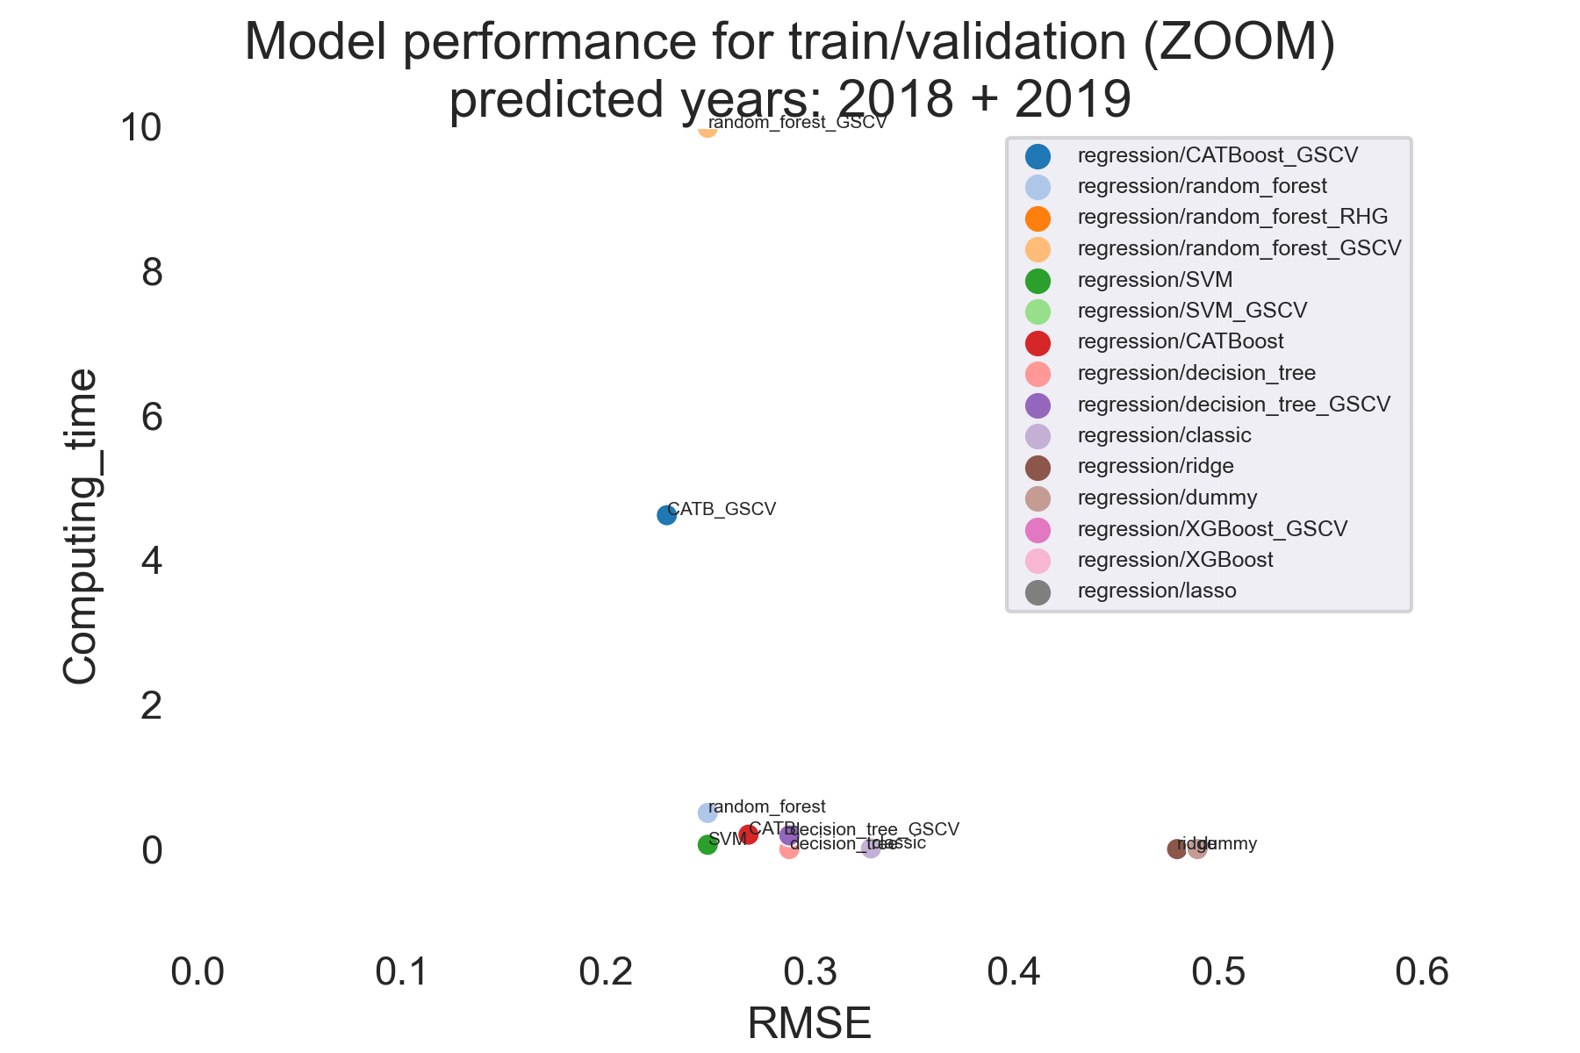
TRAIN/ VALIDATION RESULTS without EnergyStarScore
Predicted years:
2018
2019
Fixed set:
2588 buildings

Slide 49
2018 TEST RESULTS without EnergyStarScore
Part a (known buildings)
Part b (new buildings)
 |  | Model | RMSE
 | Set_part_2018
1 | a | random_forest_regressor | 0.23
2 | a | SVM_regressor | 0.25
3 | a | decision_tree_regressor | 0.29
4 | a | CATBoost_regressor | 0.30
baseline | a | dummy_regression | 0.49
Predicted years:
2018
2019
Fixed set:
2588 buildings
 |  | Model | RMSE
 | Set_part_2018
1 | b | CATBoost_regressor | 0.35
2 | b | random_forest_regressor | 0.36
3 | b | SVM_regressor | 0.37
4 | b | decision_tree_regressor | 0.38
baseline | b | dummy_regression | 0.61

Slide 50
2019 TEST RESULTS without EnergyStarScore
Part a (known buildings)
Part b (new buildings)
 |  | Model | RMSE
 | Set_part_2019
1 | a | SVM_regressor | 0.26
2 | a | decision_tree_regressor | 0.29
3 | a | random_forest_regressor | 0.29
4 | a | CATBoost_regressor | 0.29
baseline | a | dummy_regression | 0.49
Predicted years:
2018
2019
Fixed set:
2588 buildings
 |  | Model | RMSE
 | Set_part_2019
1 | b | CATBoost_regressor | 0.35
2 | b | random_forest_regressor | 0.36
3 | b | SVM_regressor | 0.37
4 | b | decision_tree_regressor | 0.38
baseline | b | dummy_regression | 0.61

Slide 51
APPENDIX B: 2019/2020 predictions without the EnergyStarScore feature

Slide 52
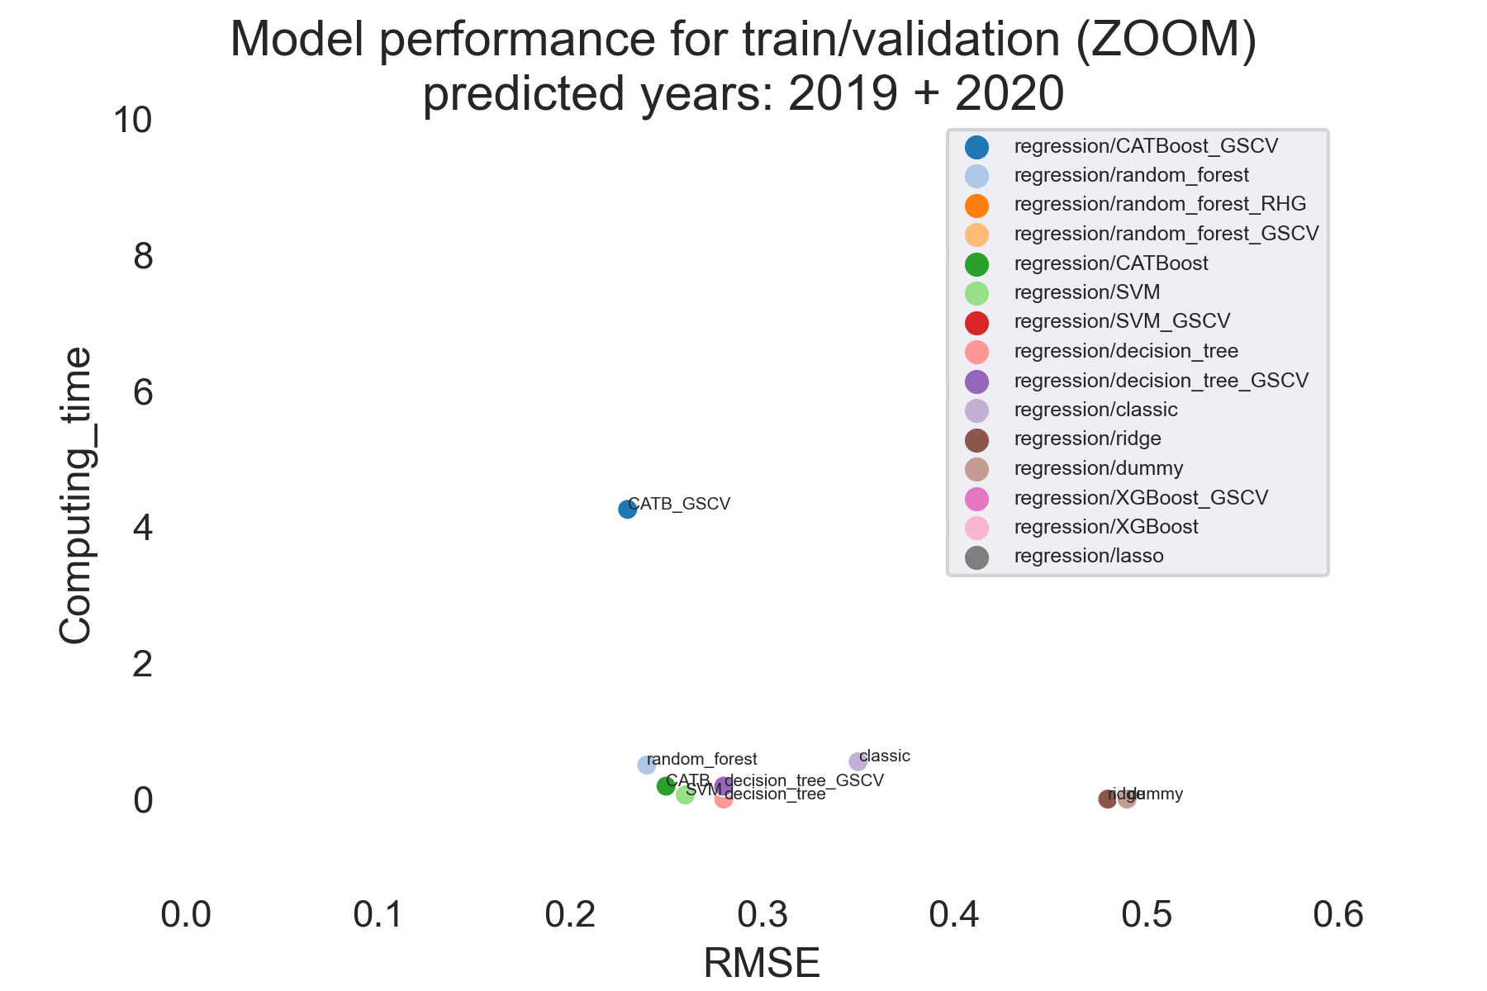
TRAIN/ VALIDATION RESULTS without EnergyStarScore
Predicted years:
2019
2020
Fixed set:
2631 buildings

Slide 53
2019 TEST RESULTS without EnergyStarScore
Part a (known buildings)
Part b (new buildings)
 |  | Model | RMSE
 | Set_part_2019
1 | a | random_forest_regressor | 0.19
2 | a | CATBoost_regressor | 0.25
3 | a | SVM_regressor | 0.25
4 | a | decision_tree_regressor | 0.28
baseline | a | dummy_regression | 0.49
Predicted years:
2019
2020
Fixed set:
2631 buildings
 |  | Model | RMSE
 | Set_part_2019
1 | b | random_forest_regressor | 0.25
2 | b | CATBoost_regressor | 0.26
3 | b | decision_tree_regressor | 0.28
4 | b | SVM_regressor | 0.30
baseline | b | dummy_regression | 0.49

Slide 54
2020 TEST RESULTS without EnergyStarScore
Part a (known buildings)
Part b (new buildings)
 |  | Model | RMSE
 | Set_part_2020
1 | a | CATBoost_regressor | 0.28
2 | a | SVM_regressor | 0.28
3 | a | decision_tree_regressor | 0.29
4 | a | random_forest_regressor | 0.29
baseline | a | dummy_regression | 0.49
Predicted years:
2019
2020
Fixed set:
2631 buildings
 |  | Model | RMSE
 | Set_part_2020
1 | b | random_forest_regressor | 0.25
2 | b | CATBoost_regressor | 0.26
3 | b | decision_tree_regressor | 0.28
4 | b | SVM_regressor | 0.30
baseline | b | dummy_regression | 0.49

Slide 55
CREDITS
Special thanks to all the people who made and released these awesome resources for free:
Presentation template by SlidesCarnival

